Slide 1

Overview of ReAct: Synergizing Reasoning and Acting in Language Models
Andrei – Răzvan, joldea

Slide 2
Introduction
Problem overview:
Large Language Models (LLMs) excel in text generation but often lack real-world actionability.
Current models struggle with tasks requiring reasoning combined with real-world actions.
Reasoning and action generation have often been studied separately.
Proposed solution:
Combine reasoning and action generation in an interleaved manner.

Slide 3
React General Overview
ReAct (Reasoning + Acting):
Combines reasoning and action generation in an interleaved manner.
Reasoning traces help the model:
Induce, track, and update action plans
Handle exceptions
Actions allow the model to:
Interface with external sources (e.g., knowledge bases, environments)
Gather additional information

Slide 4
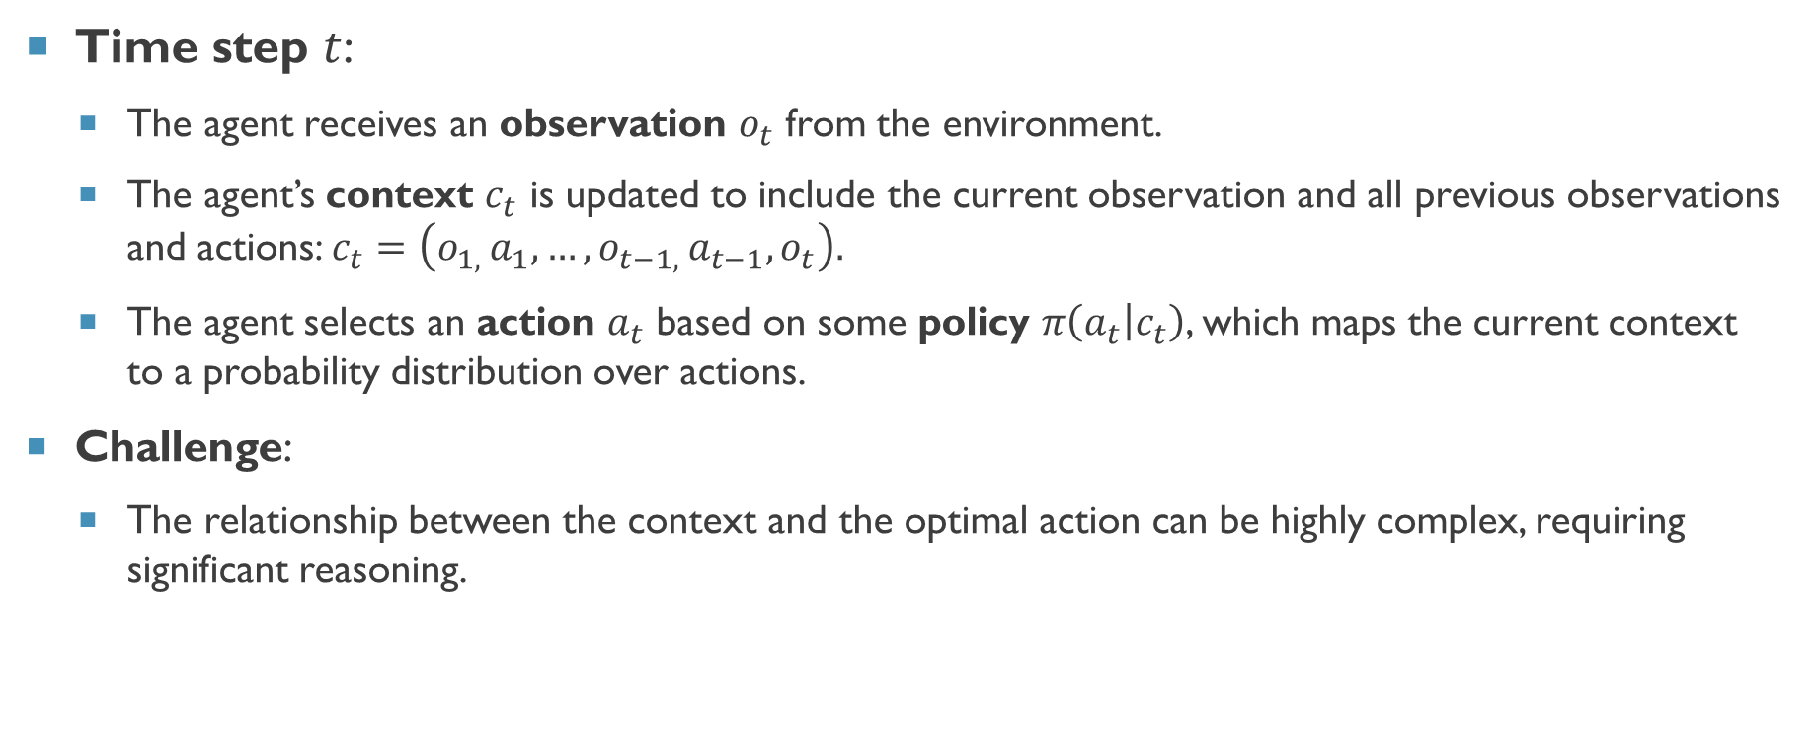
React
Time step $t$:
The agent receives an observation $o_{t}$ from the environment.
The agent’s context $c_{t}$ is updated to include the current observation and all previous observations and actions: $c_{t}=\left(o_{1, }a_{1}, …,o_{t−1, }a_{t−1}, o_{t}\right).$
The agent selects an action $a_{t}$ based on some policy $π\left(a_{t} | c_{t}\right)$, which maps the current context to a probability distribution over actions.
Challenge:
The relationship between the context and the optimal action can be highly complex, requiring significant reasoning.

Slide 5
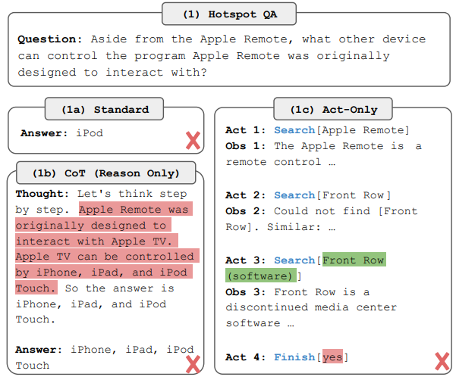

Slide 6
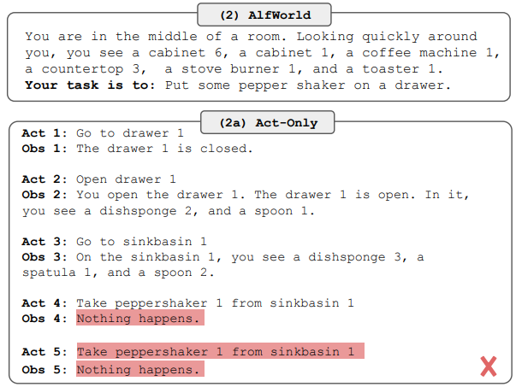

Slide 7
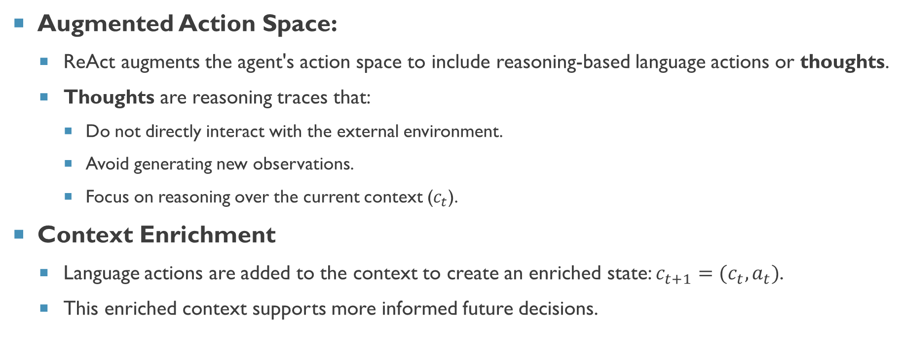
React framework overview
Augmented Action Space:
ReAct augments the agent's action space to include reasoning-based language actions or thoughts.
Thoughts are reasoning traces that:
Do not directly interact with the external environment.
Avoid generating new observations.
Focus on reasoning over the current context ($c_{t}$).
Context Enrichment
Language actions are added to the context to create an enriched state: $c_{t+1}=(c_{t}, a_{t})$.
This enriched context supports more informed future decisions.

Slide 8
React framework overview
Benefits
Task Decomposition and Planning
Incorporating Commonsense Knowledge
Observational Highlights
Progress Tracking and Plan Updates
Handling Exceptions

Slide 9
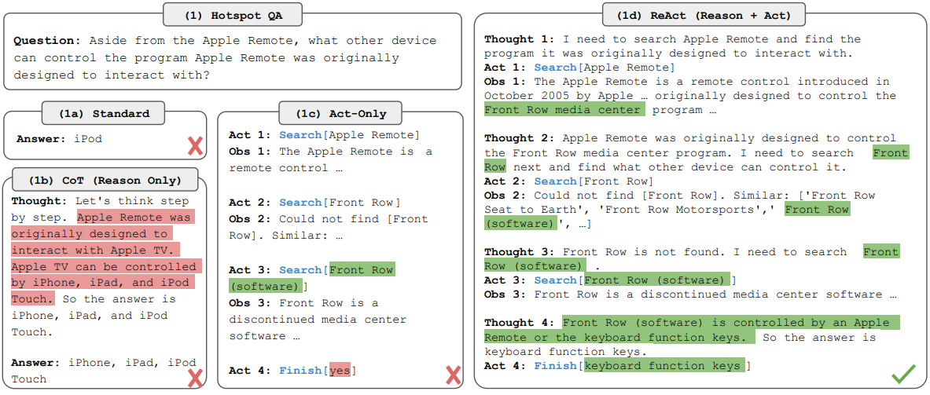

Slide 10
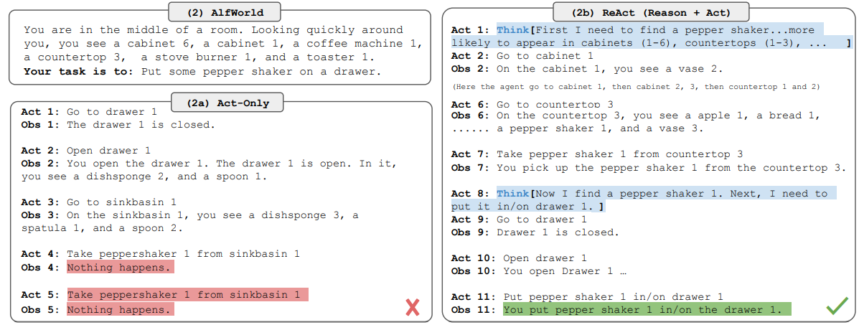

Slide 11
Evaluation
Knowledge-intensive reasoning tasks:
HotpotQA:
Multi-hop question-answering.
Requires reasoning across multiple documents.
Assesses both answer accuracy and evidence identification.
FEVER:
Fact-checking and claim verification.
Determines claim support, refutation, or unverifiability.
Retrieves evidence from a large knowledge base

Slide 12
Evaluation results
Prompt Method | HotpotQA (Exact Match) | Fever (Accuracy)
Standard | 28.7 | 57.1
CoT (Wei et al., 2022) | 29.4 | 56.3
COT-SC (Wang et al., 2022) | 33.4 | 60.4
Act | 25.7 | 58.9
ReAct | 27.4 | 60.9
COT-SC → ReAct | 34.2 | 64.6
ReAct → COT-SC | 35.1 | 62.0
Supervised SoTA | 67.5 | 89.5
Table 1: PaLM-540B prompting results on HotpotQA and Fever.

Slide 13
Evaluation results
 | Type | Definition | ReAct | CoT
Success | True positive | Correct reasoning trace and facts | 94% | 86%
 | False Positive | Hallucinated reasoning trace or facts | 6% | 14%
Failure | Reasoning error | Wrong reasoning trace (including failing to recover from repetitive steps) | 47% | 16%
 | Search result error | Search return empty or does not contain useful information | 23% | -
 | Hallucination | Hallucinated reasoning trace or facts | 0% | 56%
 | Label ambiguity | Right prediction but did not match the label precisely | 29% | 28%
Table 2: Types of success and failure modes of ReAct and CoT on HotpotQA, as well as their percentages in randomly selected examples studied by human.

Slide 14
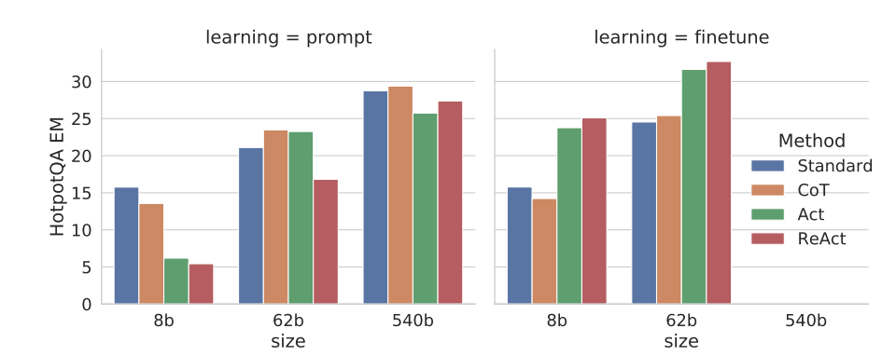

Slide 15
Evaluation
Decision making tasks:
ALFWorld:
A platform for training AI to perform tasks in 3D environments by learning from failures.
Combines symbolic simulations and realistic settings to improve robustness.
Uses natural language instructions to guide task execution (e.g., retrieving an object).
WebShop:
A framework for teaching AI to complete tasks in simulated web environments.
Focuses on goal-driven web navigation, like clicking, form-filling, and purchasing.
Handles dynamic web interfaces and ambiguous instructions (e.g., buying a product online).

Slide 16
Evaluation results
Method | Pick | Clean | Heat | Cool | Look | Pick 2 | All
Act (best of 6) | 88 | 42 | 74 | 67 | 72 | 41 | 45
ReAct (avg) | 65 | 39 | 83 | 76 | 55 | 24 | 57
ReAct (best of 6) | 92 | 58 | 96 | 86 | 78 | 41 | 71
ReAct – IM (avg) | 55 | 59 | 60 | 55 | 23 | 24 | 48
ReAct – IM (best of 6) | 62 | 68 | 87 | 57 | 39 | 33 | 53
BUTLER (best of 8) | 33 | 26 | 70 | 76 | 17 | 12 | 22
BUTLER (best of 8) | 46 | 39 | 74 | 100 | 22 | 24 | 37
Table 3: AlfWorld task-specific success rates (%)

Slide 17
EVALUATION results
Method | Score | SR
Act | 62.3 | 30.1
ReAct | 66.6 | 40.0
IL | 59.9 | 29.1
IL+RL | 62.4 | 28.7
Human Expert | 82.1 | 59.6
Table 4: Score and success rate (SR) on Webshop. IL/IL+RL

Slide 18
Conclusion
ReAct is a method combining reasoning and acting in large language models, improving performance across tasks like multi-hop question answering, fact-checking, and decision-making.
It produces interpretable decision traces but struggles with tasks requiring large action spaces due to input length limits.
Fine-tuning on datasets like HotpotQA shows promise, but further improvement depends on high-quality human annotations.
Future advancements include multi-task training and reinforcement learning to create stronger and more versatile agents.
In practice, ReAct agents are often implemented using frameworks like LangChain and LangGraph, which simplify integrating reasoning and action workflows.

Slide 19

Thank You

Slide 20
References
Yao, Shunyu, et al. "ReAct: synergizing reasoning and acting in language models (2022)." arXiv preprint arXiv:2210.03629 (2023).
Yang, Zhilin, et al. "HotpotQA: A dataset for diverse, explainable multi-hop question answering." arXiv preprint arXiv:1809.09600 (2018).
Thorne, James, et al. "FEVER: a large-scale dataset for fact extraction and VERification." arXiv preprint arXiv:1803.05355 (2018).
Shridhar, Mohit, et al. "Alfworld: Aligning text and embodied environments for interactive learning." arXiv preprint arXiv:2010.03768 (2020).
Yao, Shunyu, et al. "Webshop: Towards scalable real-world web interaction with grounded language agents." Advances in Neural Information Processing Systems 35 (2022): 20744-20757.

